Slide 2
.NET Conf 2018 Keynote
Scott Hunter, Miguel de Icaza, Mads Torgersen

Slide 3














Your platform for building anything
DESKTOP
WEB
CLOUD
MOBILE
GAMING
IoT
AI
.NET
Notes:
You can build anything with .NET. We’ve made significant investments in .NET over the years as well as unifying the ecosystem to support building literally anything.

Slide 4
.NET Growth Continues
Visual Studio
+1 million new monthly active .NET developers in last year
.NET Core
Over half a million .NET Core 2.0 developers

Slide 5
Now Available .NET Core 2.1!
www.dot.net

Slide 6
.NET Core 2.1 on TechEmpower
REQUESTS / SECOND
+15%
+18%
+147%
Data sourced from tests on TechEmpower round 16
Notes:
Call out the incredible performance increase in the REAL WORLD data access scenario.

Slide 7
.NET Core 2.1 Major Features
.NET Core
Lazy Loading
Value conversions
Query types
Data seeding
ASP.NET Core
Global Tools
Span<T>
Sockets
HttpClient Performance
Windows Compatibility Pack
EF Core
HTTPS
Razor UI as a library
HttpClientFactory
ASP.NET Core SignalR

Slide 8
Azure SignalR Service GA Sept 24 @Ignite!
Add real-time web functionalities easily with Azure and .NET Core
Enable via “services.AddSignalR().AddAzureSignalR()”
Fully managed service
No more worries about capacity provisioning, scaling, or persistent connections
Native SignalR development
</>
Use ASP.NET Core SignalR to build real-time experiences such as chat, stock tickers, live dashboards, and instant broadcasting

Slide 9
Demo: .NET Core 2.1

Slide 10
Announcing .NET Core 2.2 Preview 2
https://aka.ms/DotNetCore22

Slide 11
.NET Core 2.2 Themes
Improved Web API Development
Microservices and Azure
Continued Performance Improvements

Slide 12
.NET Core 2.2 Major Features
.NET Core
Cosmos DB provider
Spatial extensions for SQL Server and SQLite providers
Reverse engineering of database views
Collections of owned entities
Query tagging
ASP.NET Core
Multi-tier JIT compilation
SQL Connection token auth
EF Core
Template updates: Bootstrap 4, Angular 6
Web API improvements, including API security
HTTP/2
IIS in-process hosting
Health checks
Endpoint routing
SignalR Java client

Slide 13
Demo: .NET Core 2.2
Notes:
Diagnostic console – human getable

Slide 14
.NET Core 3 Update

Slide 15
.NET Core
3
2
.NET Core 3 expands supported workloads to include Windows Desktop, IoT & AI
.NET Core is perfectly suited for the requirements of cloud-native, cross-platform workloads
WEB
CLOUD
DESKTOP
IoT
AI
.NET CORE
.NET CORE 3
LIBRARIES
INFRASTRUCTURE
RUNTIME COMPONENTS
COMPILERS
LANGUAGES
Notes:
ANIMATED SLIDE – shows progression of entire .NET platform into .NET Core specific workloads.
.NET Core is our cross-platform, open source implementation of .NET and is perfectly suited for requirements of cloud-native, cross-platform services. We’ve made significant investments in the core performance as well as the web stack so that you can easily take advantage of cloud patterns and scale.
.NET Core 3 will expand on the supported workloads to include IoT, AI and Windows Desktop.

Slide 16
.NET Core 3 Desktop Improvements
.NET Core 3 supports WinForms and WPF frameworks
XAML Islands - WinForms & WPF can host UWP
XAML Controls – WinForms & WPF browser and media UWP controls
High DPI fixes for WinForms
Access to all the Windows 10 API’s
NET Core App Bundler
Precompiled, fast startup
Small apps by removing unused dependencies, link away unused IL
Single self-contained .exe

Slide 17
Why Windows Desktop on .NET Core?
Side by side
Machine global or app local framework
Core runtime and API improvements
SDK based .csproj project system

Slide 18
Update on .NET Core 3 since Build 2018
WinForms support available in nightly builds
https://github.com/dotnet/core-sdk
dotnet new winforms
Visual Studio supports building and debugging
Designers not available yet
Publish Preview later this year

Slide 19
Demo: .NET Core 3

Slide 20
Blazor

Slide 21
Experimental Blazor: .NET in the Browser
Build client-side Web UI in .NET
You don’t need to know AngularJS, React, Vue, etc
Take advantage of stability and consistency of .NET
Runs in all browsers
Native performance
Strongly typed on client and server
Requires no plugin or code transpilation
Share C# code with the client and the server

Slide 22
Razor Components (“server-side Blazor”)
Blazor programming model integrated into ASP.NET Core
Runs server-side on .NET Core
Handle client UI interactions using SignalR
Same code can run client-side on WebAssembly with no code changes
WebAssembly support remains experimental while runtime matures
Shipping in .NET Core 3.0

Slide 23
Demo: Blazor

Slide 24
Machine Learning in .NET

Slide 25
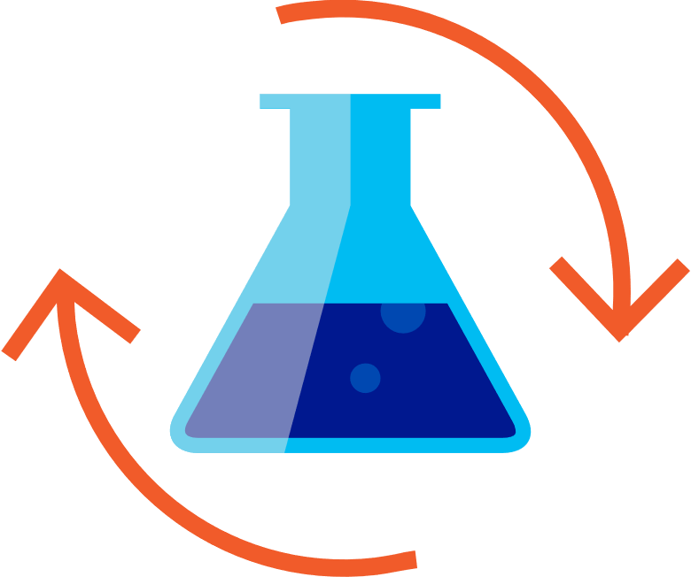

Build your own (custom) ML models
Prepare Your Data
Build & Train
Run
Notes:
ML.NET is a framework for building custom ML models

Slide 26
Announcing ML.NET 0.5!
https://aka.ms/MLNet05

Slide 27
What’s new with ML.NET?
Shipped four previews of ML.NET 0.1 - 0.5
Additional ML Scenarios
Clustering
Recommendation
Deep Learning (e.g. Image Classification with TensorFlow)
New learners and transforms
Learners: FFM, LightGBM, Ensemble, SymSGD
Transforms: LightLDA, Word Embeddings
ONNX Support
Improved F# support
Additional Train and Test options
Cross-Validation
ML.NET Samples repo
https://github.com/dotnet/machinelearning-samples

Slide 28
.NET Conf Day 2
Kick off tomorrow with Machine Learning and Artificial Intelligence in .NET!
Thursday, Sept 13th

Slide 29
C# with Mads Torgersen
Notes:
Scott to intro Mads. Mads to intro Miguel. Miguel intro Scott & Mads back on stage for farewell and enjoy the show!

Slide 30

C# 7.1, 7.2 and 7.3
C# 8.0
Safe, efficient code
Avoid garbage collection
Avoid copying
Stay safe
More freedom
Allow more things
Less code
Say it shorter

Slide 31

Copying
Garbage collection
Span<T>
This Photo by Unknown Author is licensed under CC BY

Slide 32
Span<T>

Slide 33


Slide 34
Nullable and non-nullable reference types
string? n; // Nullable reference type
string s; // Non-nullable reference type
n = null; // Sure; it's nullable
s = null; // Warning! Shouldn’t be null!
s = n; // Warning! Really!
WriteLine(s.Length); // Sure; it’s not null
WriteLine(n.Length); // Warning! Could be null!
if (n != null) { WriteLine(n.Length); } // Sure; you checked
WriteLine(n!.Length); // Ok, if you insist!

Slide 35
Mobile Development with Miguel de Icaza
Notes:
Scott to intro Mads. Mads to intro Miguel. Miguel intro Scott & Mads back on stage for farewell and enjoy the show!

Slide 36
Today
Our Community
Android Platform
Apple platforms support
Xamarin.Forms
Coming up in Xamarin

Slide 37
Open Source Contribution to Mobile
 | All Time Commits | Past Year Commits | All Time Contributors | Past Year Contributors | Pull Requests
Xamarin.Forms | 2,246 | 1,229 | 149 | 97 | 1,989
Mac/iOS/tv/Watch | 4,508 | 1,328 | 73 | 45 | 4,166
Android | 1,610 | 760 | 57 | 28 | 1,656
Mono | 114,858 | 2,433 | 966 | 125 | 9,146

Slide 38
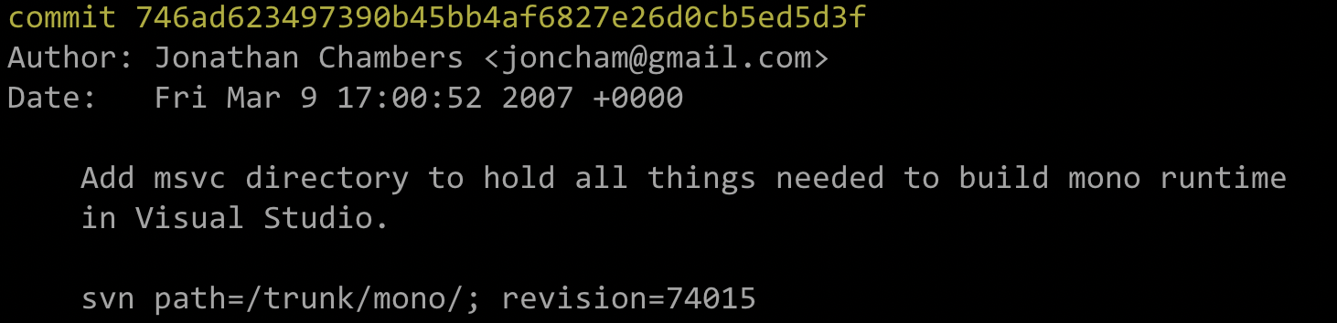
Building Mono on Windows

Slide 39
Build Mono in Visual Studio
git clone https://github.com/mono/mono.git
cd mono
git submodule update --init --recursive
msbuild msvc\mono.sln /p:MONO_TARGET_GC=sgen
msbuild bcl.sln /p:Platform="net_4_x" /restore
Targets:
Android (monodroid), iOS (monotouch), tvOS (monotouch_tv), watchOS (monotouch_watch), net_4_x, orbis (PS4), unreal (Unreal Engine), wasm, winaot, xammac xammac_net_4_5 (Mac)

Slide 40
Native Access
Native User Interfaces
Use every native control like you do from Java, Swift, Objective-C
Native Android and User Interface Designers integrated into Visual Studio
Native API Access
Native APIs are projected into .NET, 1:1 mapping
Beautified to surface the best of .NET
Native Performance
.NET Code compiled to native code with LLVM Optimizing Compiler
Same Day Support
Support the latest OS platform and APIs on launch day

Slide 41
Android

Slide 42
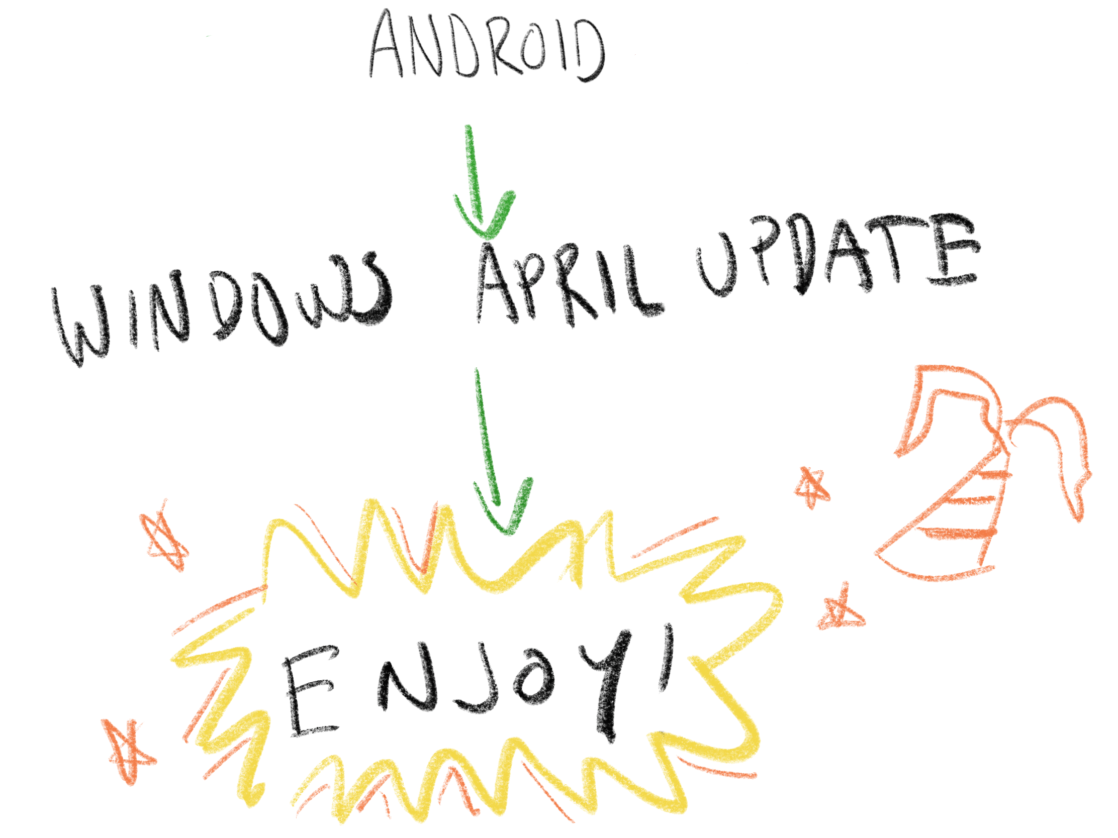
Android Emulation on Windows
Google’s Android Emulator now works on HyperV
Earlier this year:

Slide 43
Spectre Happens
Slowed down Android
New versions of Windows address this
You can try today, to be released soon.

Slide 44
Improving Build Times
Optimizing full builds
Optimize passes
Fix dependencies
Avoid unnecessary rebuilds
Optimize incremental builds
For your continuous testing

Slide 45
Creating an Android Package (APK)
Android Resource
Compilation
Resources
XAML Compile
.cs constants
.cs glue
User
C#
Code
C# Compile
Inspect for Bridgeable Elements
Compile Java
Compile DEX
DLL
.java
.dex
Extract Java and Native Libraries
.aar
Process
Result shipped in final APK
.so
Intermediate file

Slide 46
Cumulative Results – Complex app
Smart Hotel 360 application
25,000 lines of C#
99 NuGet packages
47 from .NET standard
16 Android Support Libraries (“extras”)
5 Google Play Services
3 Azure
26 other (Skia + native code, Splat, Plugins, NewtonSoft.Json, helpers)
32 XAML screens
Stable release (15.9): 02:15s
Current master: 0:57s

Slide 47
Fast Forms Inner Loop
Android Resource
Compilation
Resources
XAML Compile
.cs constants
.cs glue
User
C#
Code
C# Compile
Inspect for Bridgeable Elements
Compile Java
Compile DEX
DLL
.java
.dex
Extract Java and Native Libraries
.aar
.so
Process
Result shipped in final APK
Intermediate file

Slide 48
Speeding up your Workflow
Rebuild and run in 3 seconds
Proof of concept “Xamarin.Android.Lite”

Slide 49
iOS 12 Xcode 10

Slide 50
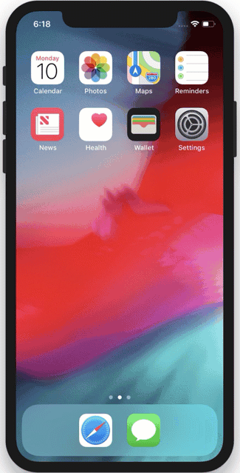
Shortcuts – Intents, Siri Integration
Surface your app to Siri
Your app can be part of a script
App “Donates” actions to the OS, that can be searched, replayed, and can have parameters.

Slide 51
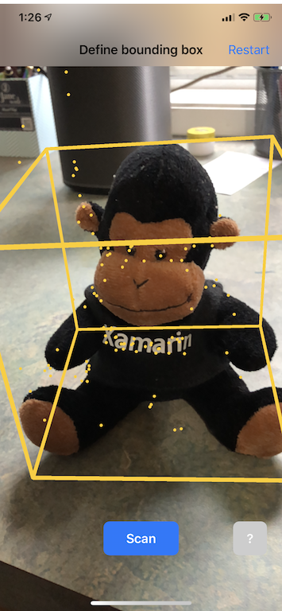
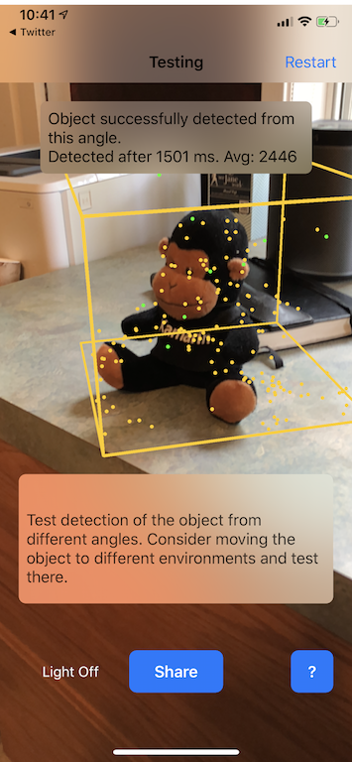
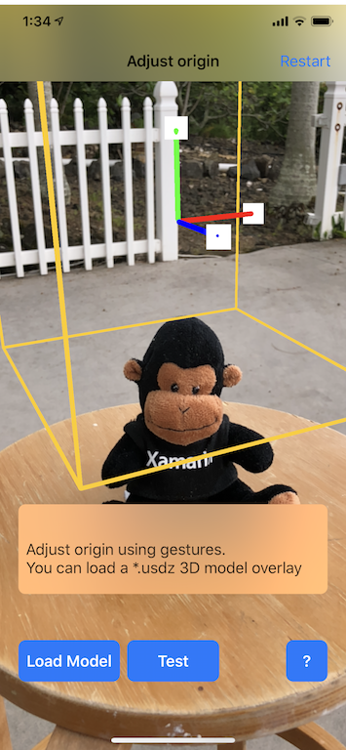
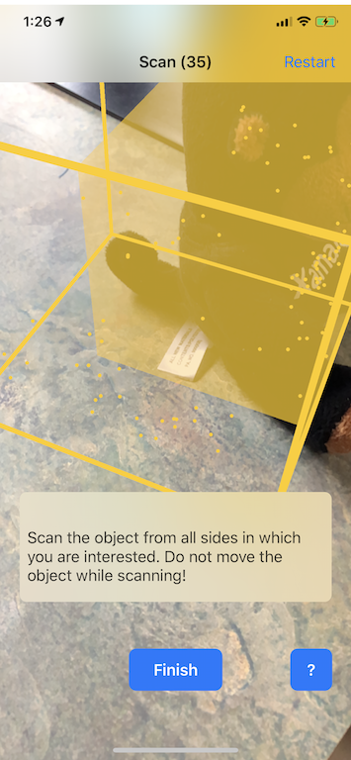
ARKit 2.0 3D object detection, world sharing

Slide 52
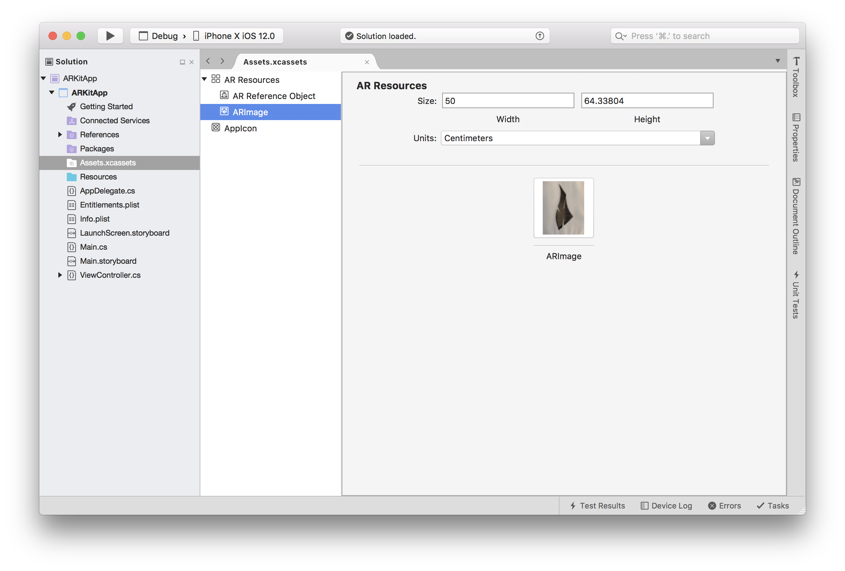
ARKit – Custom Objects

Slide 53
New Network Stack (NW* APIs) Sample: https://github.com/migueldeicaza/netcatnetwork
Simple and modern network stack
Connection
Data Transfer
Mobile friendly
Radio on demand
Built-in state machine
Filter network types
Plain or TLS
TCP or UDP
DNS or Bonjour
User-land networking stack
Congestion Control
Fast open connections
Path transitions
Multi-path connections
Monitor connection

Slide 54
NWConnection CreateOutboundConnection (string name, string port)
{
var endpoint = NWEndpoint.Create (name, port);
parameters = NWParameters.CreateSecureTcp (configureTls: null, configureTcp: null); var connection = new NWConnection (endpoint, parameters);
connection.SetQueue (DispatchQueue.MainQueue);
connection.SetStateChangeHandler ((state, error) => {
var remote = connection.Endpoint;
var errno = (SslStatus)(error != null ? error.ErrorCode : 0);
switch (state){
case NWConnectionState.Waiting:
warn ($"Connect to {remote.Hostname} port {remote.Port} failed, is waiting");
break;
case NWConnectionState.Failed:
warn ($"Connect to {remote.Hostname} port {remote.Port} failed, error {errno}");
break;
case NWConnectionState.Ready:
warn ($"Connect to {remote.Hostname} port {remote.Port} succeeded");
break;
case NWConnectionState.Cancelled:
connection = null;
break;
}
});
connection.Start ();
}

Slide 55
More on iOS 12 to try today
CoreML custom layers and custom models (IDE support in progress).
CarPlay integration
Grouped Notifications
Interactive Controls in Notifications

Slide 56
Forms - Shell

Slide 57

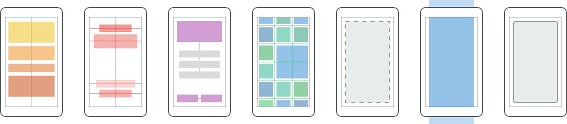
Content
MasterDetail
Navigation
Tabbed
Carousel
Stack
Absolute
Relative
Grid
ContentView
ScrollView
Frame
ActivityIndicator
BoxView
Button
DatePicker
Editor
Entry
Image
Label
ListView
Map
OpenGLView
Picker
ProgressBar
SearchBar
Slider
Stepper
TableView
TimePicker
WebView
EntryCell
ImageCell
SwitchCell
TextCell
ViewCell

Slide 58

Picture of Lego Mess – Lego creatin

Slide 59
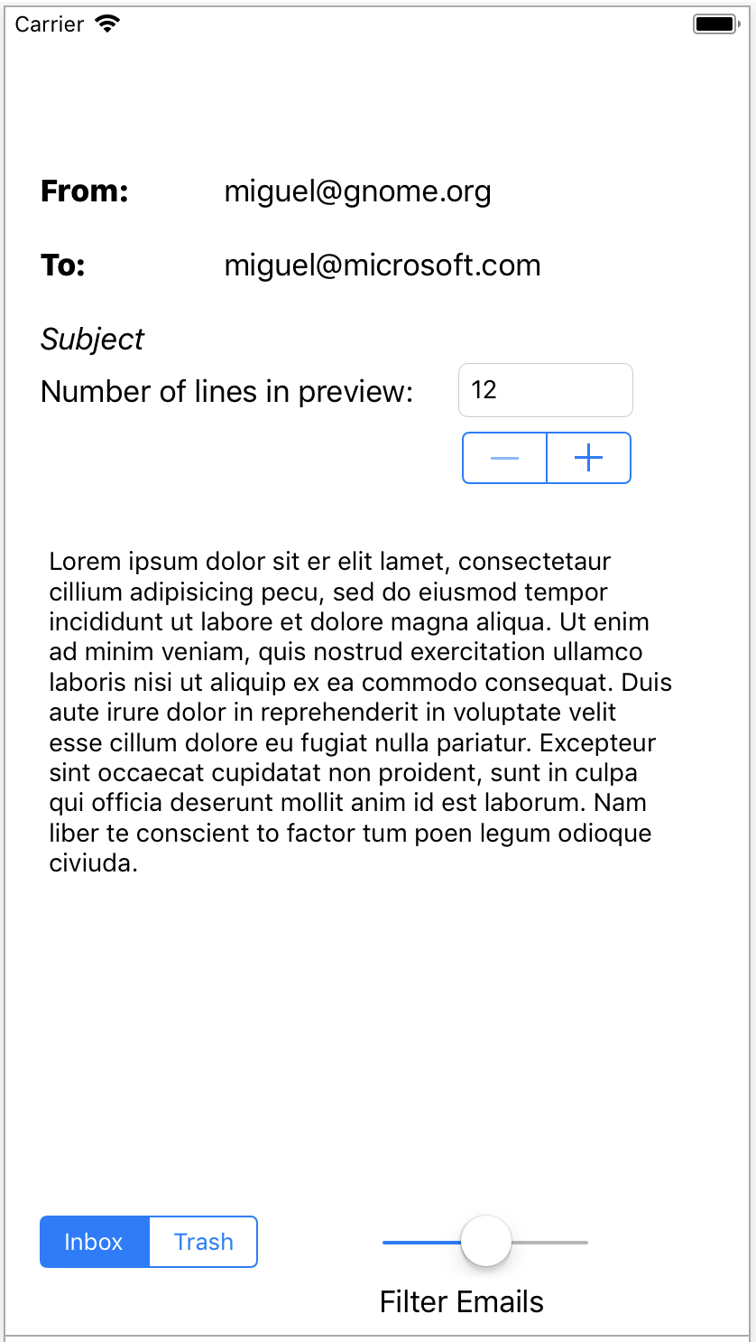

Slide 60
What is Shell?
An optional skeleton for your application
Opinionated, batteries included approach - new Shell type
Structured
You fill in the content
We give you a consistent look and feel
Global settings, and you can style with CSS
We handle navigation

Slide 61
More about the Shell
Deep linking
Pages get URLs assigned
Your app can launch into the provided URL
We handle search for you
We handle Material look for you

Slide 62
A Taste of Shell

Slide 63
And on iOS

Slide 64
Xamarin.Forms Shell
<?xml version="1.0" encoding="UTF-8" ?> <Shell xmlns="http://xamarin.com/schemas/2014/forms" xmlns:x="http://schemas.microsoft.com/winfx/2009/xaml" xmlns:local="clr-namespace:Xamarin.Store" x:Class="Xamarin.StoreDemoApp" Route="s"> <Shell.FlyoutHeader> <local:HeaderView /> </Shell.FlyoutHeader> <Shell.MenuItems> <MenuItem x:Name="preferencesMenuItem" Text="Preferences" Icon="prefs.png" /> <MenuItem x:Name="logOutMenuItem" Text="Logout" Icon="logout.png" /> </Shell.MenuItems> <ShellItem Route="home" Title="Home" Icon="home.png" GroupBehavior="ShowTabs"> <ShellTabItem Route="updates" Title="Home" Icon="home.png"
ContentTemplate="{DataTemplate local:HomePage}" /> <ShellTabItem Route="games" Title="Games" Icon="games.png"
ContentTemplate="{DataTemplate local:GamesPage}" /> <ShellTabItem Route="settings" Title="Settings" Icon="games.png"
ContentTemplate="{DataTemplate local:SettingsPage}" /> </ShellItem> <ShellItem Route="apps" Title="Media" Icon="media.png"> <ShellTabItem Route="books" Title="Books" Icon="books.png"
ContentTemplate="{DataTemplate local:BooksPage}" /> <ShellTabItem Route="music" Title="Music" Icon="music.png"
ContentTemplate="{DataTemplate local:MusicPage}" /> <ShellTabItem Route="movies" Title="Movies" Icon="movies.png"
ContentTemplate="{DataTemplate local:MoviesPage}" /> </ShellItem> </Shell>
Notes:
Opinionated default application shell
Developers fill in the blanks
Instead of assembling app from parts
Removes repetitive steps
Embraces Native Platform
Handles Navigation
Platform consistency (Shell and MaterialShell)
Handles application Urls

Slide 65
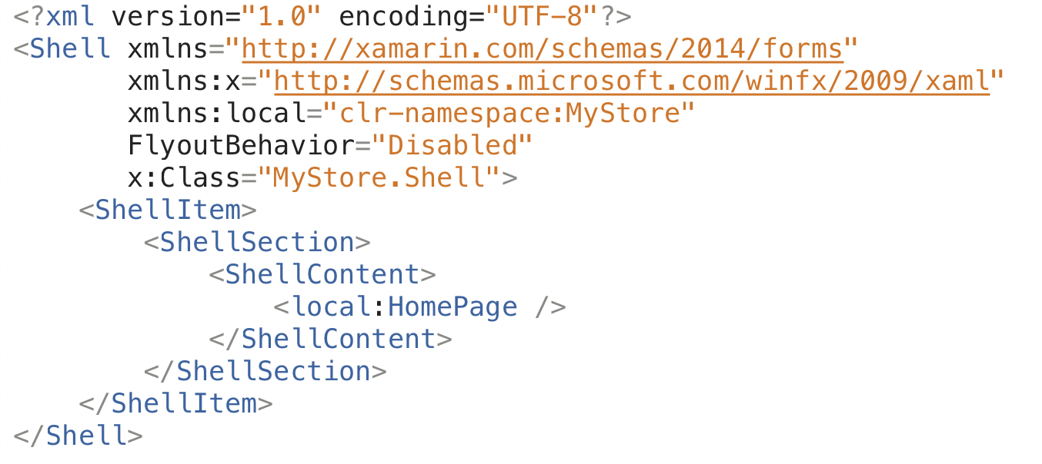
Simple one page app

Slide 66
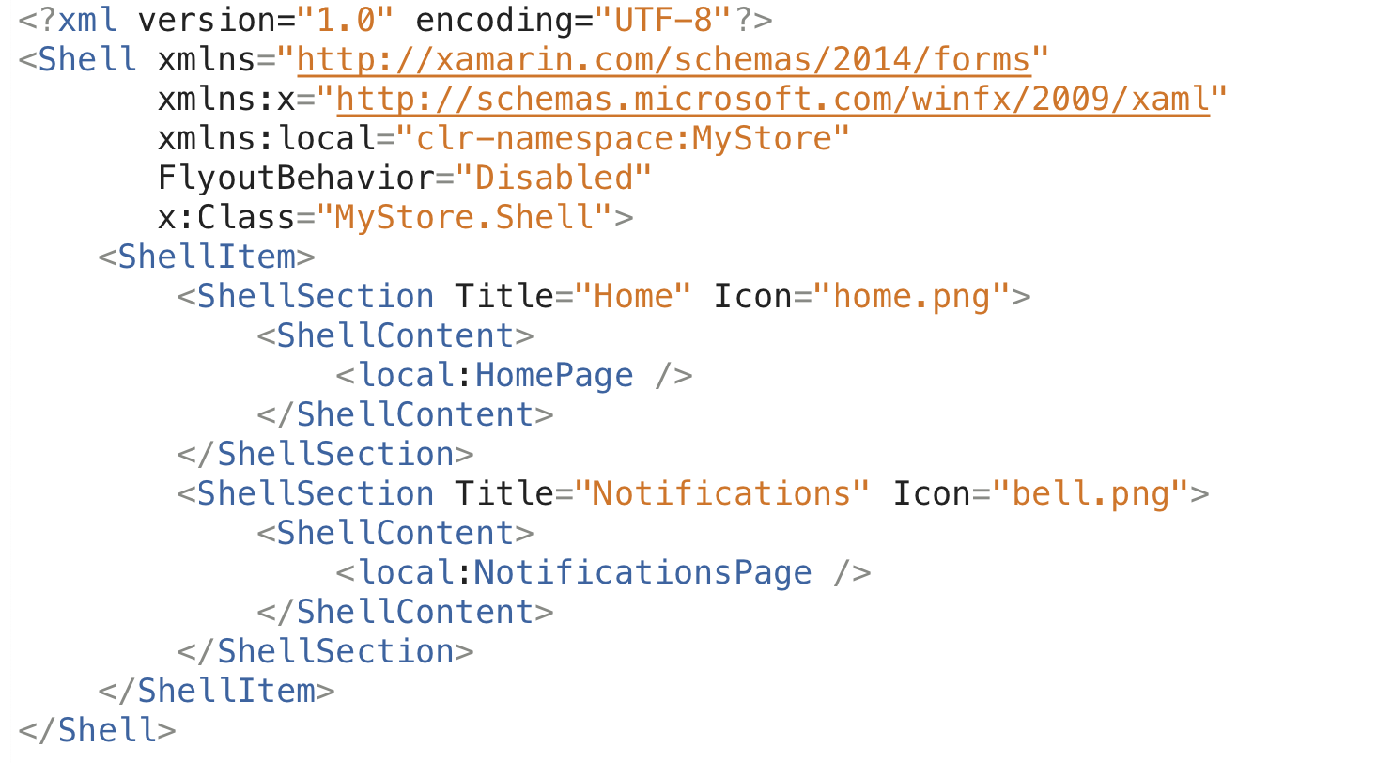
Two pages with bottom tabs

Slide 67
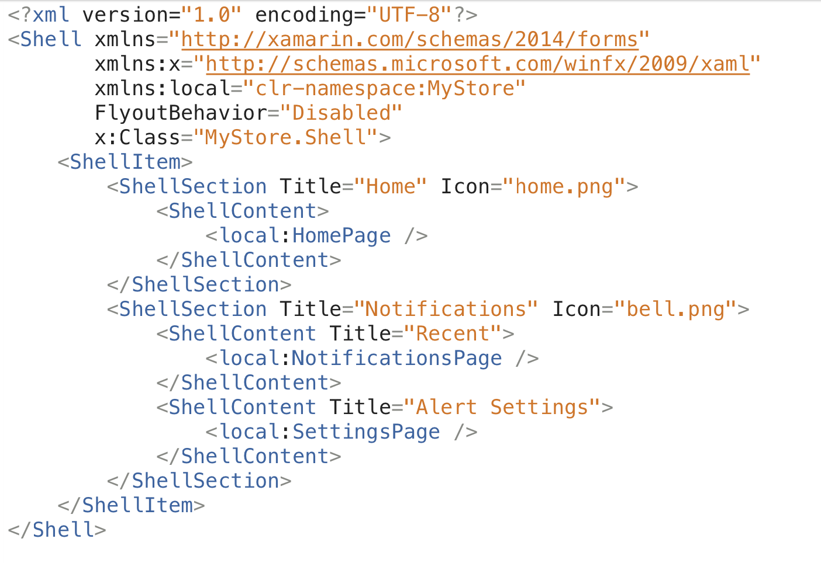
More than one ShellContent

Slide 69
CollectionView CarouselView

Slide 70
CollectionView https://github.com/xamarin/Xamarin.Forms/issues/3172
Supports Horizontal/Vertical layouts
Backed by the native collection views where necessary
A modern ListView
No longer uses Cells
Uses regular Views and DataTemplates

Slide 71
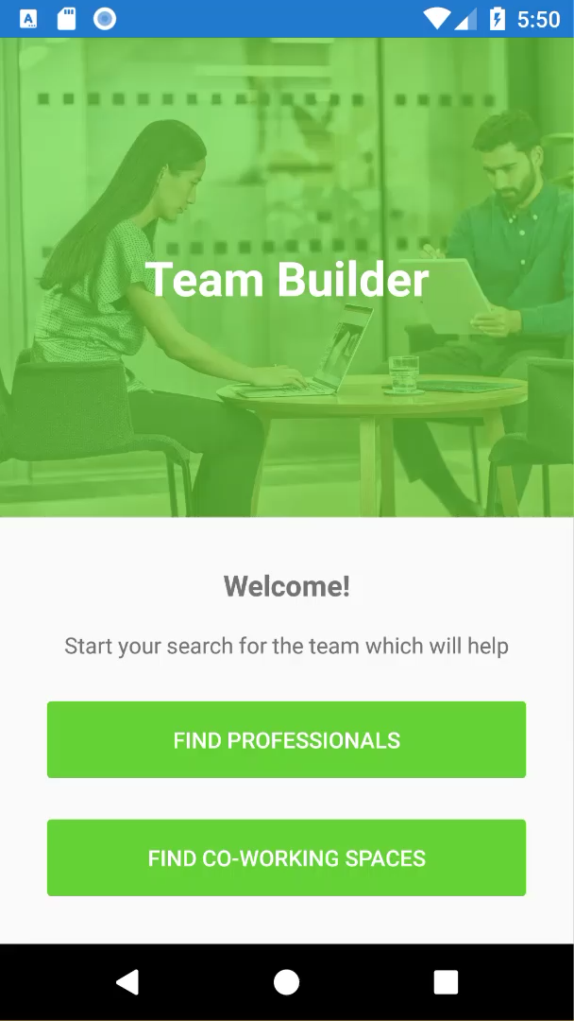

Slide 72
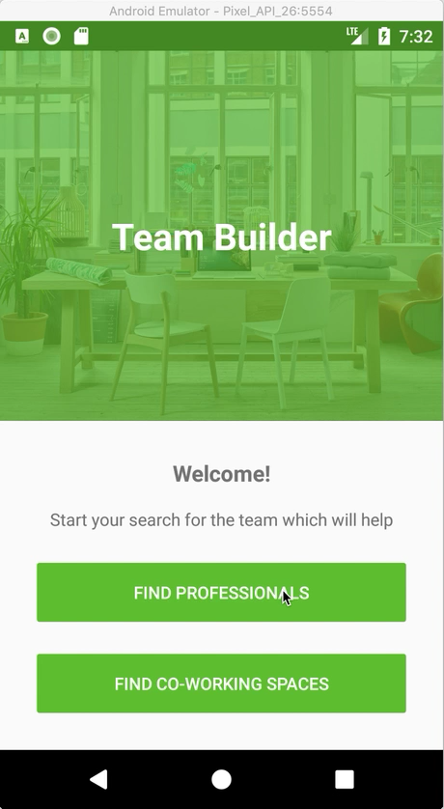
Carousel

Slide 73
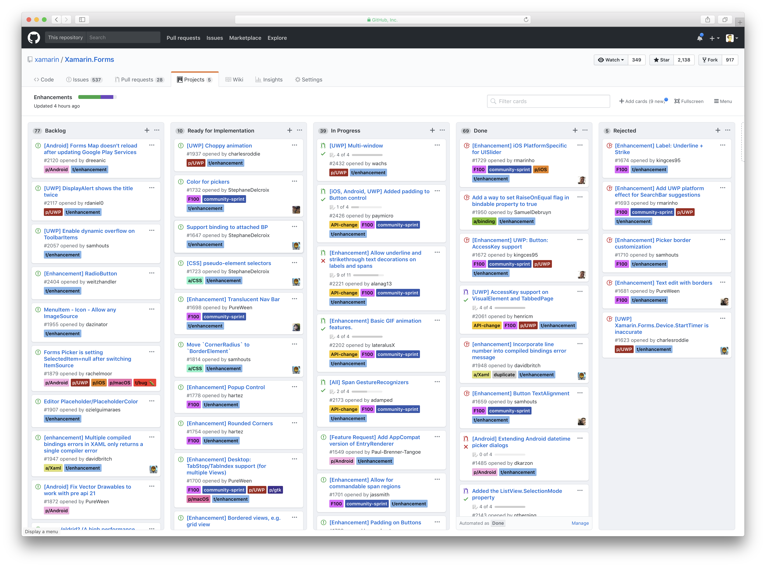
Forms – Project F100

Slide 74
Xamarin Essentials A kit of essential cross platform APIs for your mobile apps – Native Android, Native iOS or Forms
Accelerometer
File System Helpers
Preferences
App Information
Email
Screen lock
Battery State
Geocoding
Secure Storage
Clipboard
Geolocation
SMS
Compass
Gyroscope
Text to Speech
Connectivity
Magnetometer
Version tracking
Data Transfer
Open Browser
Vibrate
Device Information
Phone Dialer

